Slide 1
Archaeology
Leonardo Maduro-Salvarrey

Slide 2
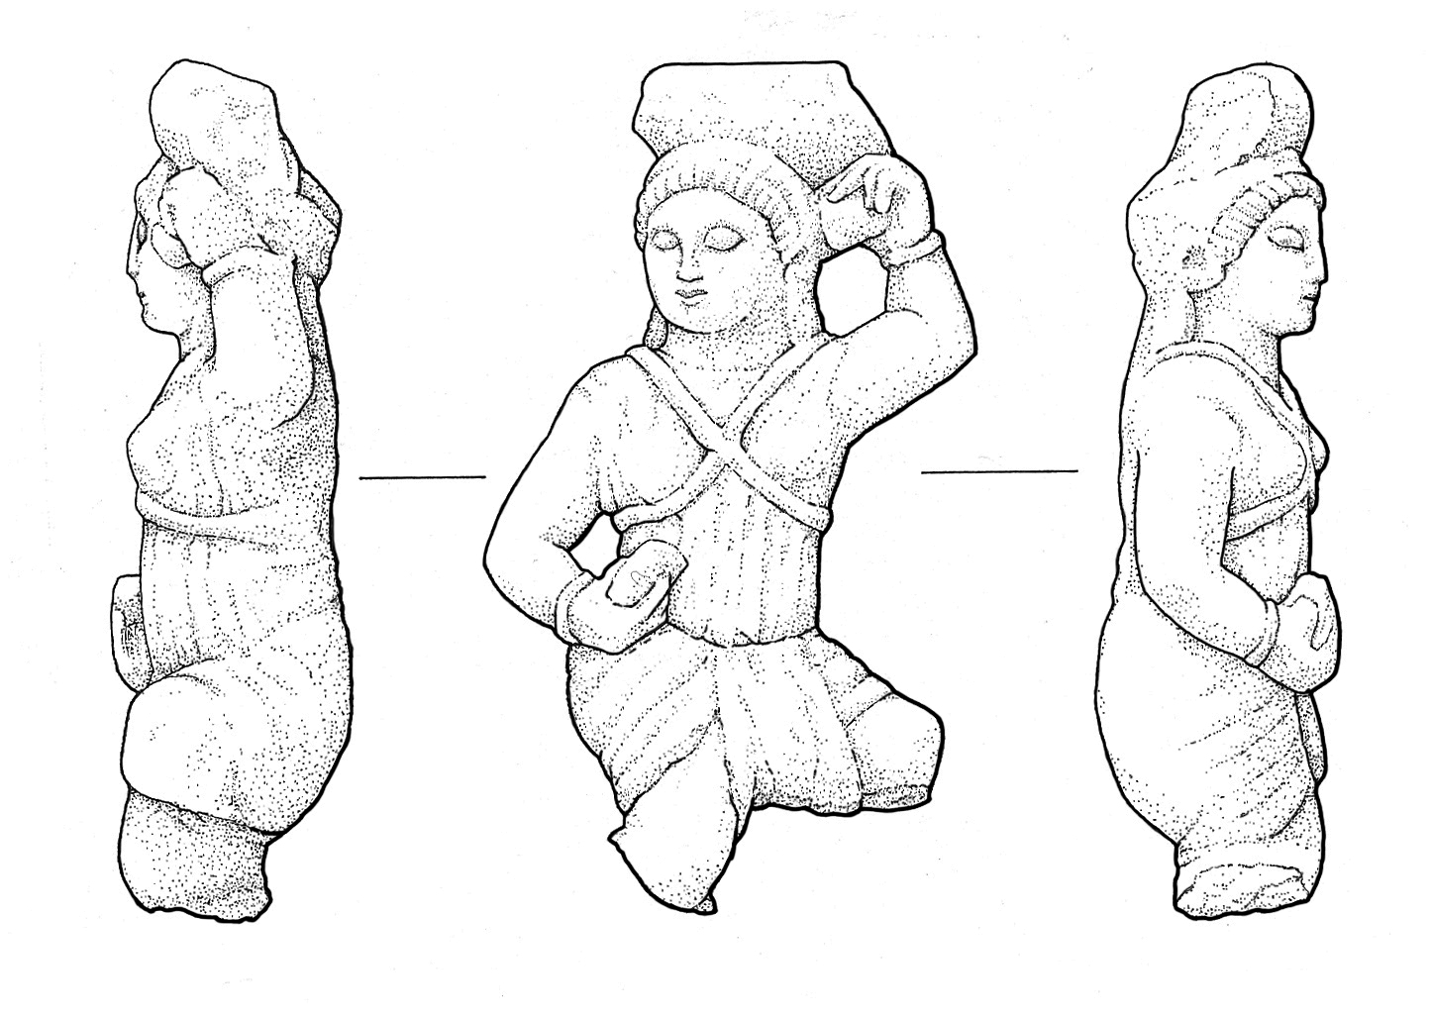
Required Skills
Attention to detail
Drawing ability
Developed writing ability
Understanding of historical events

Slide 3

Income
Local annual income averages approximately $62,000.
Typical annual salary for anthropology and archaeology postsecondary teachers is $59,610 - $117,480

Slide 4

Availability
Localized mostly to institutions of learning
Not in high demand

Slide 5
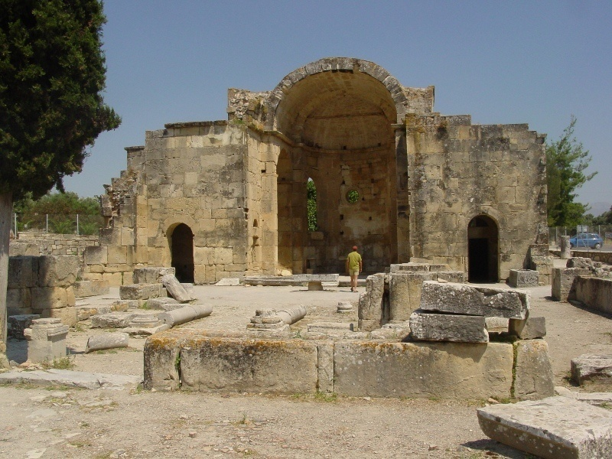
Required Experience
Positions in this field of study require at least a Master’s degree or PhD in Archaeology or Anthropology

Slide 6
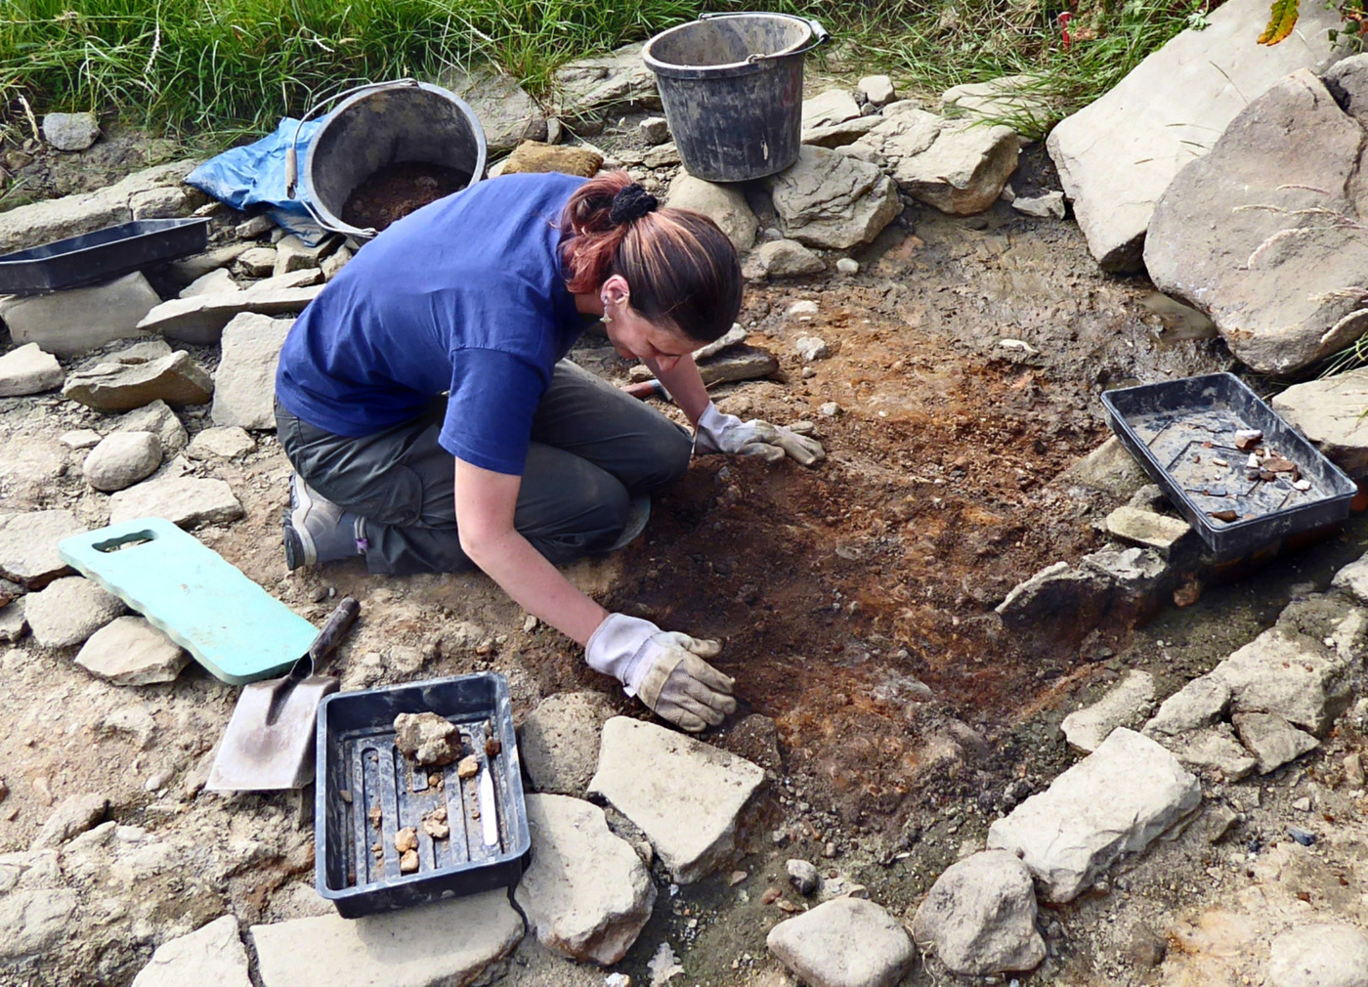
Nature of the Work
Some manual labor in the field is required (moving equipment/supplies).
Lots of excavation work on the field, in addition to writing
Precise records of where and in which context an artifact is found in must be taken.

Slide 7
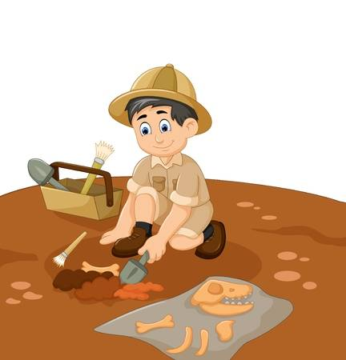
Personal Experience
AP World History and Art History in high school.
Currently taking Archaeology and Prehistory

Slide 8
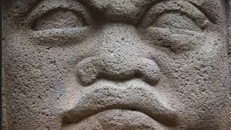
Questions?

Slide 9
Works Cited
Woelfel, Valerie. “Artifact Drawings.” Archaeological Illustration-Artifact Drawings, Archaeoillustrator, 2010, www.archaeoillustrator.com/Artifact_Drawings.html.
Matt. “Lowes.” Current Archaeology, Current Archaeology, 28 Feb. 2018, www.archaeology.co.uk/digs/fieldwork/bury-archaeological-group-4.htm.
Glassdoor, www.glassdoor.com/Job/jobs.htm?suggestCount=0&suggestChosen=true&clickSource=searchBtn&typedKeyword=ARchaeolog&sc.keyword=Archaeologist&locT=C&locId=1155583&jobType=.
“CareerOneStop.” CareerOneStop, 5 Oct. 2017, www.careeronestop.org/site-search.aspx?keyword=Archaeology.
“Summary.” U.S. Bureau of Labor Statistics, U.S. Bureau of Labor Statistics, 30 Apr. 2018, www.bls.gov/ooh/life-physical-and-social-science/anthropologists-and-archeologists.htm.

